Slide 1
Earth Care: At RUC, At Home, and Resources to Help
WED@7
1/26/2022
Rockville United Church

Slide 2
2019 Data
https://www.bbc.com/news/world-asia-57018837

Slide 3
https://www.ucc.org/what-we-do/justice-local-church-ministries/justice/faithful-action-ministries/environmental-justice/

Slide 4
https://presbyearthcare.org/

Slide 5
https://www.facebook.com/groups/MCFACS/permalink/1078687236284239/?sfnsn=mo&ref=share

Slide 6
https://www.montgomerycountymd.gov/green/climate/climate-action-planning.html
https://www.montgomerycountymd.gov/green/Resources/Files/climate/draft-climate-action-plan.pdf

Slide 7
https://www.rockvillemd.gov/2329/Climate-Action-Plan

Slide 8
25.0% Electricity & Heat 20.4% Agriculture & Land 17.9% Industry 14.0% Transportation 9.6% Other Energy 6.7% Food Waste 6.4% Buildings

Slide 9
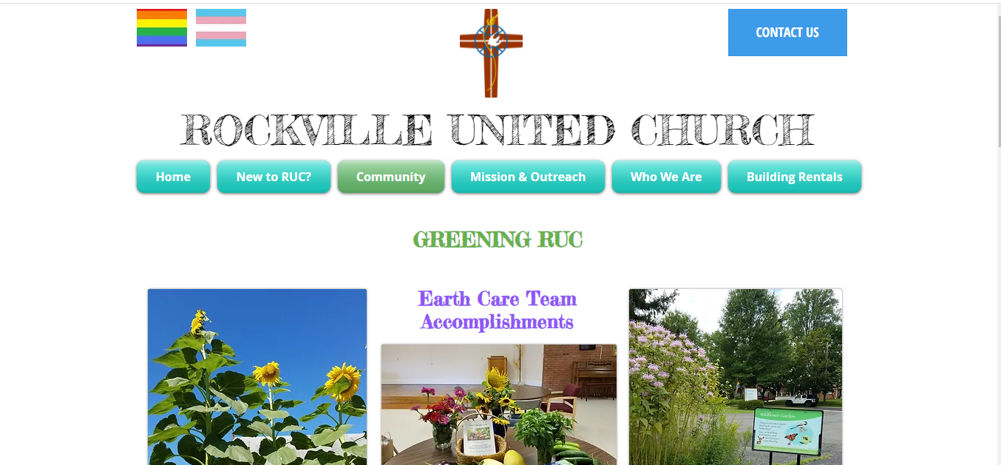
https://www.rockvilleunitedchurch.org/green
https://www.rockvilleunitedchurch.org/green

Slide 10
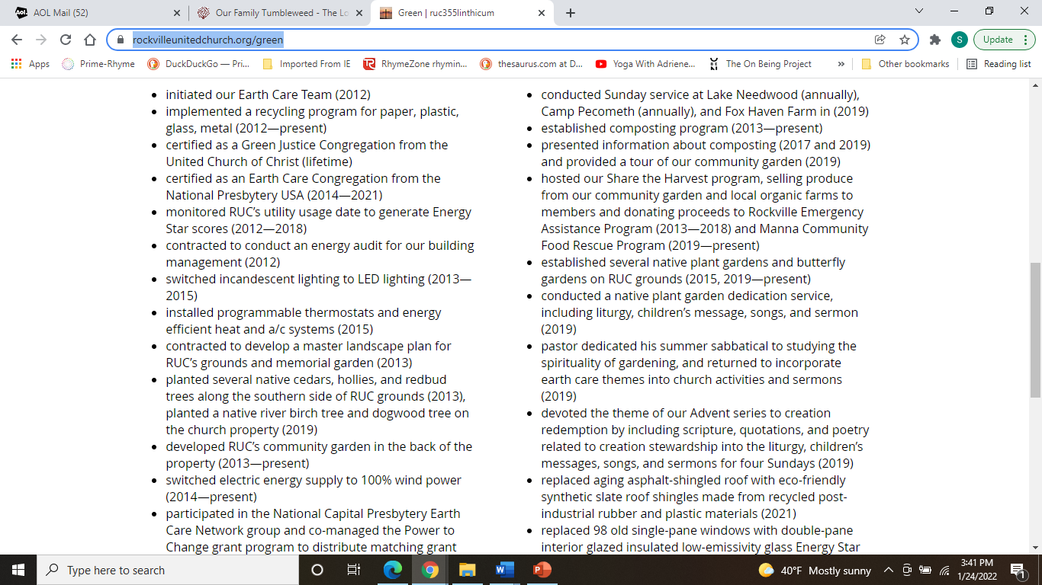

Slide 12
What more can RUC do?

Slide 13
What More Can RUC Do?
Looking for volunteers to:
Join the RUC Earth Care Team
Help calculate trends in RUC utility use over time
enter gas and electric data into EPA Portfolio Manager application to calculate Energy Star Score
Help submit our annual application to recertify RUC as an Earth Care Congregation
monitor and report Earth care activities once a year
Participate in the National Capital Presbytery’s Earth Care Network
attend quarterly meetings on Saturday mornings
Help Rockville Rotary Club plant the Monarch Butterfly Garden
one workday
Cut garden flowers from RUC grounds and prepare for the sanctuary altar
Cut garden flowers from RUC grounds and deliver to RUC members and friends
Participate in RUC workdays for grounds maintenance
Manage collection of old CDs/DVDs at RUC for recycling and deliver to Shady Grove Transfer Station
Manage collection of textiles at RUC for recycling and deliver to Shady Grove Transfer Station
Manage collection of Styrofoam at RUC for recycling and deliver to Crofton, MD

Slide 14
What are you already doing at home?
What might you do in the future?
What barriers do you encounter?

